Slide 1
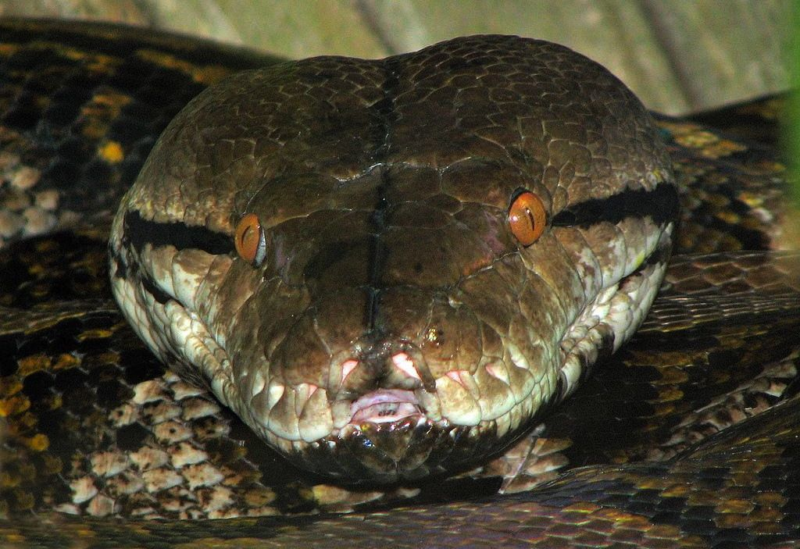
CHAPTER 10 EXCEPTIONAL HANDLING

Slide 2
Unit 2:
XI
Computer Science (083)
Board : CBSE
Computational Thinking and Programming
Courtesy CBSE

Slide 3
CHAPTER 10 EXCEPTIONAL HANDLING

Slide 4
ERRORS
Error is a abnormal condition whenever it occurs execution of the program is stopped.
An error is a term used to describe any issue that arises unexpectedly that cause a computer to not function properly. Computers can encounter either software errors or hardware errors.

Slide 5
ERRORS
Errors are mainly classified into following types.
1. Syntax Errors
2. Semantic Errors
3. Run Time Errors.
4. Logical Errors.

Slide 6
1. Syntax Errors
Syntax errors refer to formal rules governing the construction of valid statements in a language.
Syntax errors occur when rules of a programming language are misused i.e., when a grammatical rule of the language is violated.

Slide 7
1. Syntax Errors
For instance in the following program segment,
def main()
a=10
b=3
print(“ Sum is “,a+b
: (Colon) Missing
) Missing

Slide 8
2. Semantic Errors
Semantics error occur when statements are not meaningful
Semantics refers to the set of rules which give the meaning of the statement.
For example,
Rama plays Guitar
This statement is syntactically and semantically correct and it has some meaning.

Slide 9
2. Semantic Errors
See the following statement,
Guitar plays Rama
is syntactically correct (syntax is correct) but semantically incorrect. Similarly, there are semantics rules of programming language, violation of which results in semantical errors.
X * Y = Z
will result in semantical error as an expression can not come on the left side of an assignment statement.

Slide 10
3. Run Time Errors.
A Run time error is that occurs during execution of the program. It is caused because of some illegal operation taking place.
For example
1. If a program is trying to open a file which does not exists or it could not be opened(meaning file is corrupted), results into an execution error.
2. An expression is trying to divide a number by zero are RUN TIME ERRORS.

Slide 11
4. Logical Errors.
A Logical Error is that error which is causes a program to produce incorrect or undesired output.
for instance,
ctr=1;
while(ctr<10):
print(n *ctr)

Slide 12
Exceptions

Slide 13
Exceptions
What is an exception?
Even if a statement or expression is syntactically correct, it may cause an error when an attempt is made to execute it. Errors detected during execution are called exceptions

Slide 14
Exceptions
For Example

Slide 15
Handling Exceptions

Slide 16
Handling Exceptions
It is possible to write programs that handle selected exceptions. Look at the following example, which asks the user for input until a valid integer has been entered, but allows the user to interrupt the program (using Control-C or whatever the operating system supports); note that a user-generated interruption is signalled by raising the KeyboardInterrupt exception.

Slide 17
Handling Exceptions
For Example

Slide 18
Handling Exceptions
The try statement works as follows.
First, the try clause (the statement(s) between the try and except keywords) is executed.
If no exception occurs, the except clause is skipped and execution of the try statement is finished.

Slide 19
Handling Exceptions
The try statement works as follows.
If an exception occurs during execution of the try clause, the rest of the clause is skipped. Then if its type matches the exception named after the except keyword, the except clause is executed, and then execution continues after the try statement.

Slide 20
Handling Exceptions
The try statement works as follows.
If an exception occurs which does not match the exception named in the except clause, it is passed on to outer try statements; if no handler is found, it is an unhandled exception and execution stops with a message as shown above.

Slide 21
The except Clause with No Exceptions

Slide 22
The except Clause with No Exceptions
You can also use the except statement with no exceptions defined as follows:
try:
You do your operations here;
except:
If there is any exception, then execute this block…..
else:
If there is no exception then execute this block. Contd..

Slide 23
The except Clause with No Exceptions
This kind of a try-except statement catches all the exceptions that occur. Using this kind of try-except statement is not considered a good programming practice though, because it catches all exceptions but does not make the programmer identify the root cause of the problem that may occur.

Slide 24
Example

Slide 25
Example

Slide 26
raise statement

Slide 27
raise statement
You can raise an exception in your own program by using the raise exception.
Raising an exception breaks current code execution and returns the exception back until it is handled.
Syntax:
raise [expression1[, expression2]]

Slide 28
raise Example

Slide 29
raise Example

Slide 30
Some common exceptions

Slide 31
Some common exceptions
IOError
If the file cannot be opened.
ImportError
If python cannot find the module.
ValueError
Raised when a built-in operation or function receives an argument that has the right type but an inappropriate value.

Slide 32
Some common exceptions
KeyboardInterrupt
Raised when the user hits the interrupt key (normally Control-C or Delete).
EOFError
Raised when one of the built-in functions (input() or raw_input()) hits an end-of-file condition (EOF) without reading any data

Slide 33
CLASS TEST

Slide 34
CLASS TEST
Time: 40 Min Max Marks: 20
Explain the types of errors 05
2. What is an exception? Explain in detail 05
3. What is raise? explain in detail 05
4. Explain some of the common built in exceptions provided in python 05

Slide 35
Thank You

